Slide 1
Long Short Term Memory within Recurrent Neural Networks
Tyler fricks

Slide 2
Overview
Types of Neural Networks for Background
Perceptron
Feed Forward
Denoising
RNN’s and LSTM
Training Recurrent Neural Networks
Gradient Methods
2nd Order Optimization

Slide 3
Overview: Continued
RNN Design Tools and Frameworks
TensorFlow
Matlab
Others
Examples of LSTM Networks in use:
DRAW
Speech Recognition
Others

Slide 4
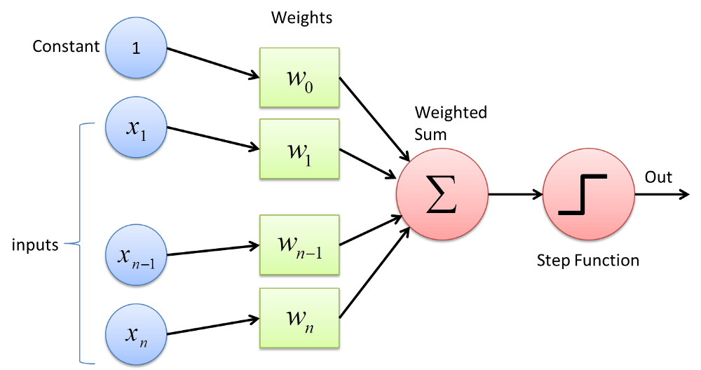
Types of ANN’s: Perceptron
Very simple, single neuron classification
Works well for linearly separable data

Slide 5
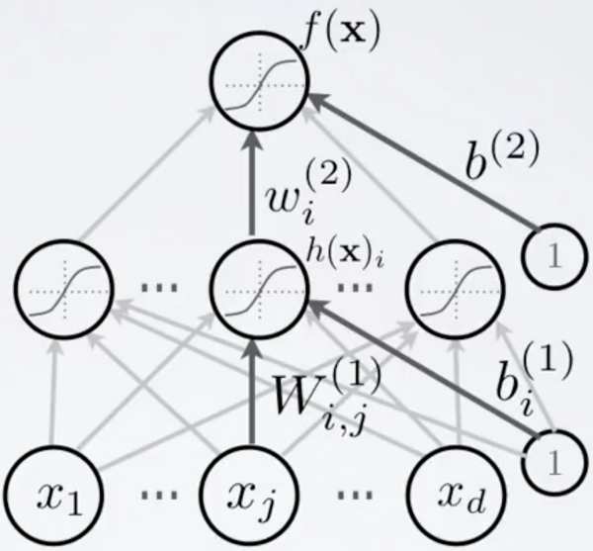
Types of ANN’s: Feed Forward
Multiple layers of perceptron, or other neurons with different activation functions
All information flows in one direction

Slide 6
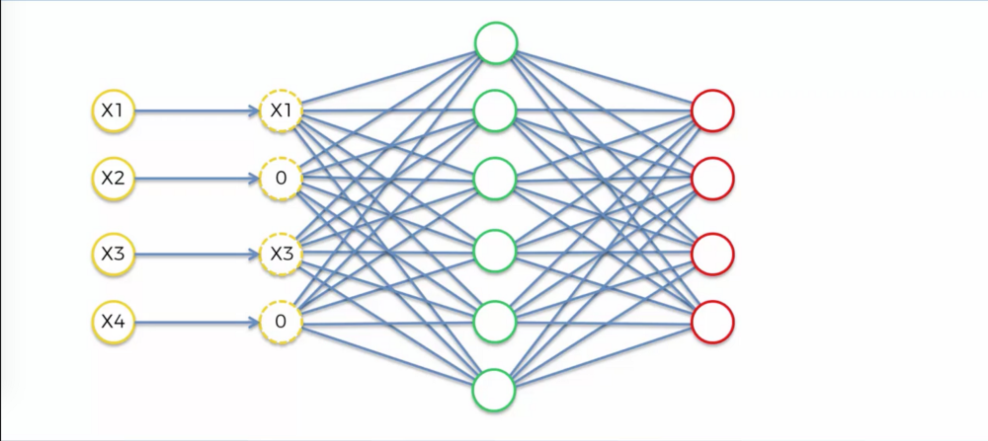
Types of ANN’s: Denoising
Removes noise from data
Assist with feature selection
Cleaner data is easier to work with
More nodes in hidden layer than inputs

Slide 7
Types of ANN’s: Denoising Example
Original Corrupted Denoised

Slide 8
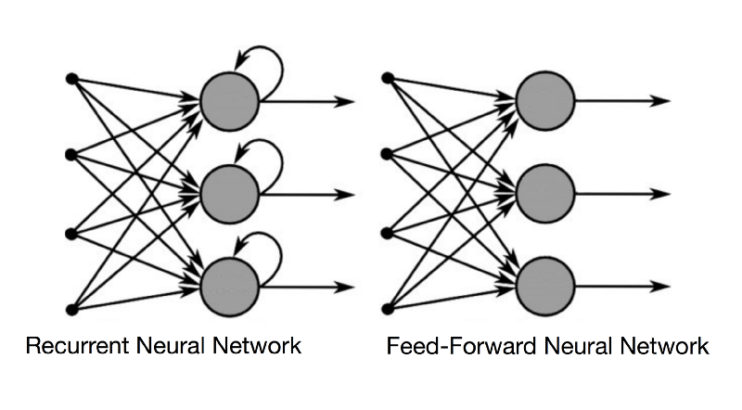
Recurrent Neural Networks
Developed in the 1980’s
Computer power too low to pursue
Based on Feed Forward networks
Added Short Term Memory to neurons
RNN Neurons have access to the current data and the result of one time-step in the past.

Slide 9
RNN Advantages Over Feed Forward
Feed Forward Networks can’t base decisions off of the past data
Because of this, predictions are near impossible to make
Example: A neural network is reading a string “Apple” character by character. Both networks are predicting the letter after the second P.
FF Network has every letter available to predict
RNN Network can rule out unpronounceable letter combinations.

Slide 10
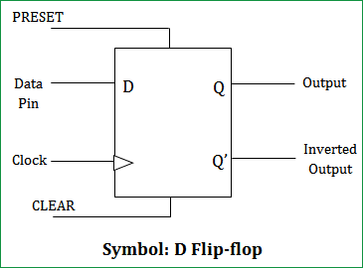
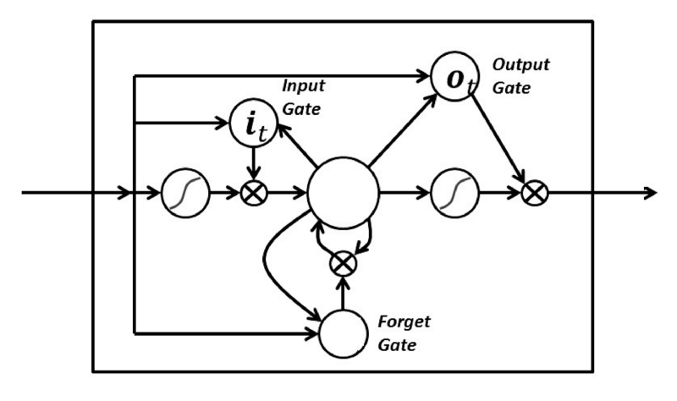
Long Short Term Memory Networks
Based on RN Networks
Adds memory control to each neuron
Similar to D Flip Flop Circuit
Gates are usually sigmoid.

Slide 11
Long Short Term Memory Networks Advantages
Extends prediction ability
Memory is not restricted to Present and one back in time
Gradients are kept steep
Vanishing gradient problem is less of an issue

Slide 12
Training Methods for RNN’s: Gradient Methods
Backpropagation Through Time (Gradient Discovery Method)
Sending error values backwards with respect to time
Requires “Unfolding” the network at each time-step.
Allows discovery of layer contribution
Vanishing Gradient Problem
Over time, contribution of the inner-layers moves towards zero.
Reported error rates get low, causing terrible training speed.

Slide 13
Training Methods for RNN’s: Gradient Methods
Exploding Gradient Problem
Opposite of Vanishing Gradient
Caused by training of long sequences of data
Training speed ends up being way too high
Scholastic Gradient Decent
Method of finding the local minimum of the error/loss function.
Allows for exploration/exploitation functions like GridWorld

Slide 14
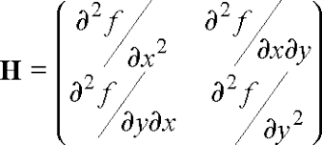
Training Methods for RNN’s: 2nd Order Optimization
New training method
Attempts to find the Global Minima
Not affected by vanishing/exploding gradient problems
Takes a huge amount of thought and computing power to implement. Hessian matrix must be computed
2nd order refers to differential equations

Slide 15
RNN Design Tools and Frameworks: Tensorflow
Open Source, Developed by Google
“an open source library for high performance numerical computation across a variety of platforms”
Supports Python, JavaScript, C++, Java, Go, and Swift
Provides GPGPU support for faster training

Slide 16
RNN Design Tools and Frameworks: Matlab Deep Learning Toolbox
Addon for Matlab
Graphical design of neural networks
Costly
Matlab license: $2,150
Deep Learning Toolbox: $1000

Slide 17
RNN Design Tools and Frameworks: PyTorch
Successor to Torch for Lua
Primary competitor to Tensorflow
Faster
Slightly more difficult to use, less API support

Slide 18
RNN Design Tools and Frameworks: Misc
Scikit
Collection of algorithms for learning
DL4J
Eclipse Foundation’s learning framework with GPGPU support
Weka
Developed by University of Waikato. For educational learning.

Slide 19
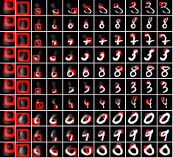
DeepMind DRAW
Deep Recurrent Attentive Writer
Image Generation, as a human would draw
Update over time
Depends on a 2D array of Gaussian filters to avoid the vanishing gradient problem.

Slide 20
Speech Recognition
Usually LSTM networks due to predictive ability
Again, if the last letter predicted was “C”, “X” would be ruled out as the next letter.

Slide 21
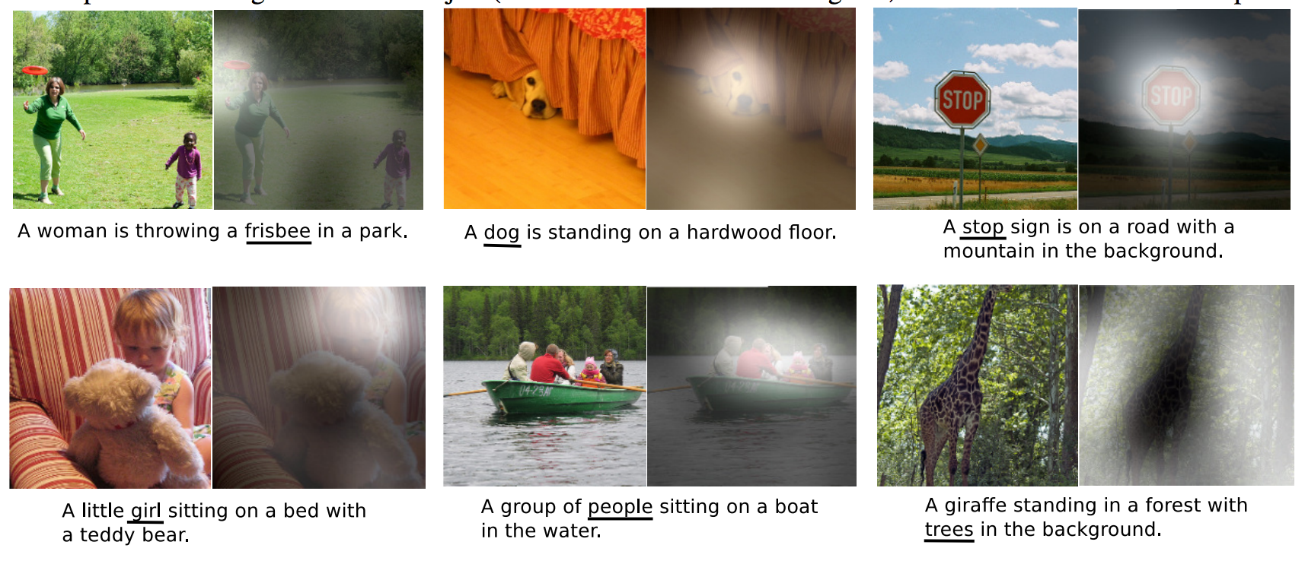
Image Captioning
Automatically categorize images based on recognized features
Save humans hours of tedious work.
Convolutional neural network is used to condition images.

Slide 22
Anomalies in a Time Series
Detection of “out of the ordinary” data in a time series.
EKG Data, for example could have a bad wave detected by a neural network.

Slide 23
Conclusion

Slide 24
Questions

